Slide 1
Pizza sales
Analyzing the pizza sales and getting useful insights from the data using MySQL

Slide 2
This presentation provides insights derived from a detailed analysis of pizza sales data using SQL, focusing on sales performance.

Slide 3
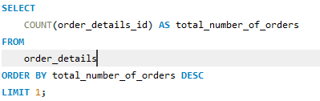

1. Retrieve the total number of orders placed

Slide 4
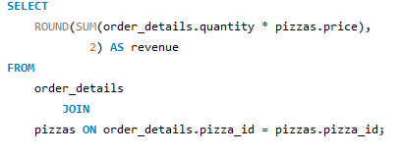

2. Calculate the total revenue generated from pizza sales

Slide 5
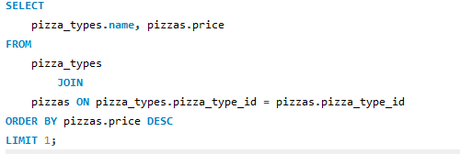

3.Identify the highest-priced pizza

Slide 6
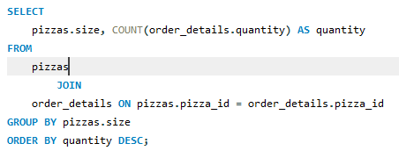
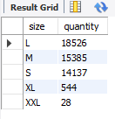
4. Identify the most common pizza size ordered

Slide 7
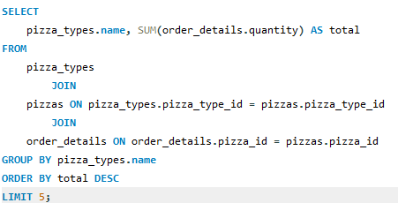
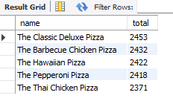
5. List the top 5 most ordered pizza types along with their quantities

Slide 8
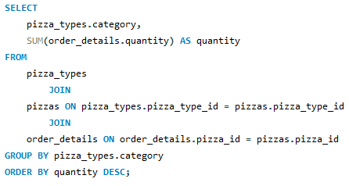
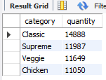
6. Join the necessary tables to find the total quantity of each pizza category ordered

Slide 9
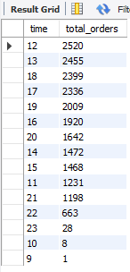
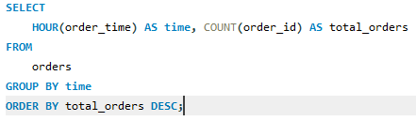
7. Determine the distribution of orders by hour of the day

Slide 10
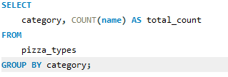
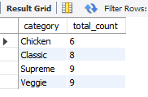
8. Join relevant tables to find the category-wise distribution of pizzas

Slide 11
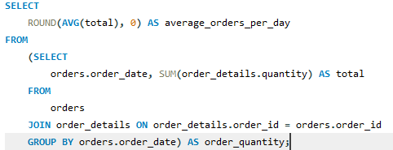

9. Group the orders by date and calculate the average number of pizzas ordered per day

Slide 12
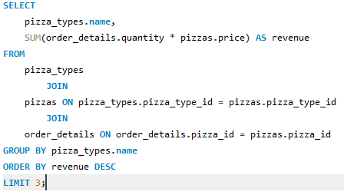

10. Determine the top 3 most ordered pizza types based on revenue

Slide 13
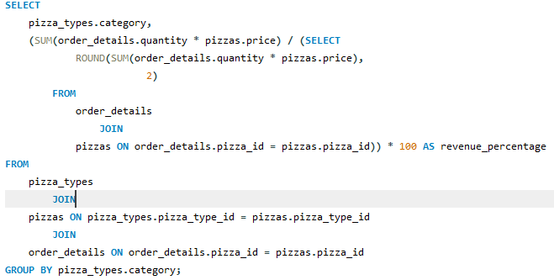
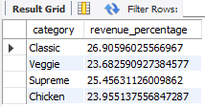
11. Calculate the percentage contribution of each pizza type to total revenue

Slide 14
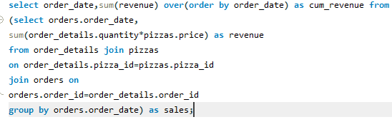
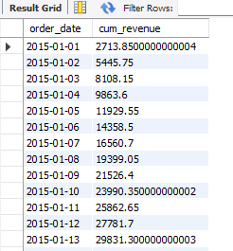
12. Analyze the cumulative revenue generated over time

Slide 15
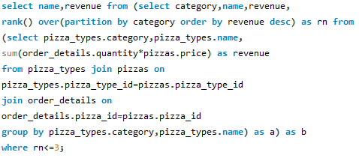
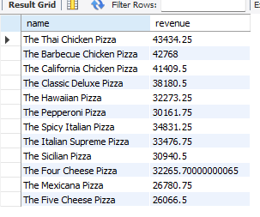
13. Determine the top 3 most ordered pizza types based on revenue for each pizza category

Slide 16
Thank You
Summary Statement:
This analysis has highlighted key insights to optimize sales strategies , enhance product offerings, and improve overall business performance.

